Slide 1

Ewald-Oseen extinction theorem
Hüseyin Serhat Tetikol

Slide 2
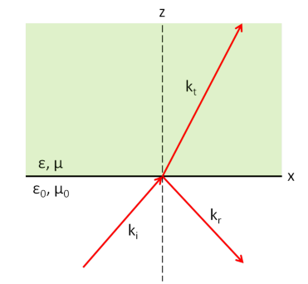
Ewald-Oseen extinction theorem
An electromagnetic plane wave is incident on a dielectric-vacuum interface. As a result, a reflected wave and a transmitted wave are generated. We can easily calculate the properties (amplitudes, propagation directions, speeds) of these waves using Maxwell’s equations.

Slide 3
Ewald-Oseen extinction theorem
The reflection occurs at the same angle as the angle of incidence.
Transmitted wave travels at a different angle and at a slower speed (c/n).
Both the transmitted and the reflected waves are still plane waves.
These are remarkable conclusions!

Slide 4
Ewald-Oseen extinction theorem
How on earth do we get such a neat and simple result? The dielectric is a collection of atoms or molecules whose individual behaviours are much more complex than these results. Do these atoms or molecules conspire to give us unexpectedly simple results, or is there something else at play?
Many dipoles
?
?
Much more complex behaviour
Simple behaviour

Slide 5
Ewald-Oseen extinction theorem
The conventional way of solving this problem does not answer these questions because it does not really explain how the dielectric behaves at the microscopic level. It assumes that the medium has a “macroscopic” description and follows from there.

Slide 6
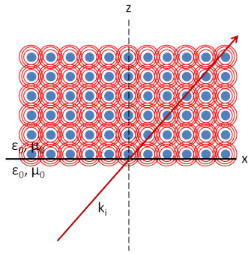
Ewald-Oseen extinction theorem
This is where Ewald-Oseen extinction theorem comes in. It replaces the dielectric with a collection of particles which act as electric dipoles, as shown. There is no media anymore: The entire space is vacuum, half of which is occupied by the dipoles. This picture is reasonable as we know that materials are made of atoms/molecules that more or less act like electric dipoles.
Blue dots are the dipoles.
Red circles are their radiation.

Slide 7
Ewald-Oseen extinction theorem
The incident wave travels at the speed of light c everywhere, since there is no media but only vacuum.
The indicent wave does not change direction, for the same reason.
The incident wave excites the dipoles, and the total field at any point is given by the summation of the incident field and the fields generated by the dipoles (which also travel at the speed of light).
Blue dots are the dipoles.
Red circles are their radiation.

Slide 8
Ewald-Oseen extinction theorem
The theorem shows that the summation of the incident field and the fields generated by the dipoles magically give one plane wave in the upper half-space and one in the lower half-space: The former seems to travel slower and in a different direction (the transmitted wave), the latter travels with the same speed c, reflected by the angle of incidence.
Blue dots are the dipoles.
Red circles are their radiation.

Slide 9




Ewald-Oseen extinction theorem
Let’s define the problem
The incident wave:
The fields generated by the dipoles:
The total field:
Blue dots are the dipoles.
Red circles are their radiation.

Slide 10
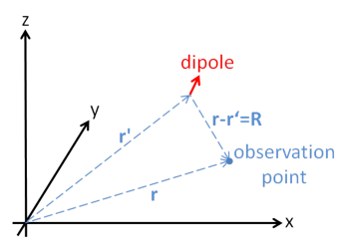



Ewald-Oseen extinction theorem
The field generated by a single dipole:

Slide 11


Ewald-Oseen extinction theorem
What is left is to find by summing the fields of all dipoles. A dipole will be polarized due to the total electric field acting on it. In our case, the total field acting on a dipole is the incident electric field plus the fields generated by all the other dipoles! This is, indeed, the same as the total electric field we defined previously. We can assume that the dipoles form a continuous distribution in z > 0 region. The dipole moment of a unit volume will simply be the polarization density of the medium.
Blue dots are the dipoles.
Red circles are their radiation.

Slide 12

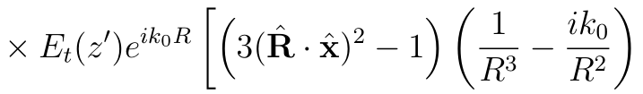
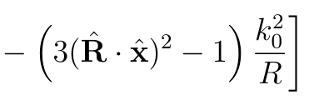
Ewald-Oseen extinction theorem
We put p into E. Then multiply with to get the amplitude and integrate over the upper half-space.
Blue dots are the dipoles.
Red circles are their radiation.

Slide 13

Ewald-Oseen extinction theorem
Evaluating the integral over x an y,
Integrating over x and y gives us a slice of dipoles perpendicular to the z axis.
This slice radiates plane waves (due to the polarizing field acting on it) in both positive and negative z directions.
Each slice radiates a plane wave with a different magnitude and phase, and all this integral does is add these plane waves coherently.
Blue dots are the dipoles.
Red circles are their radiation.

Slide 14



Ewald-Oseen extinction theorem
We can also write the total field as,
or
Blue dots are the dipoles.
Red circles are their radiation.

Slide 15

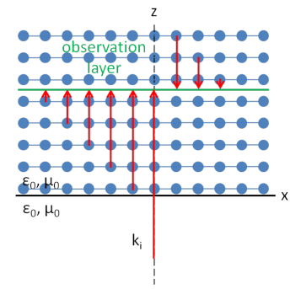

Ewald-Oseen extinction theorem
The first integral (above) from 0 to z represent forward propagating waves and originate from the dipole layers below z.
The second integral represent backward propagating waves and originate from layers above z.
Forward and backward propagating waves originating from different
layers and contributing the total field at the observation layer.

Slide 16







Ewald-Oseen extinction theorem
Using as the trial solution, we get
This result indicates
and
which gives
and

Slide 17


Ewald-Oseen extinction theorem
We can also find
which is exactly what we were looking for. The fields generated by the dipoles exactly cancel the incident field, leaving behind a wave that propagates at a speed of c/n!

Slide 18
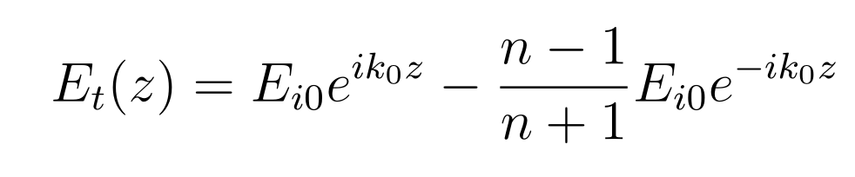
Ewald-Oseen extinction theorem
A similar derivation leads to the reflected field:

Slide 19
Ewald-Oseen extinction theorem
A few scientists who initially got the theorem wrong:
  Max Born
  Emil Wolf
  John David Jackson
  Paul Peter Ewald
  Carl Wilhelm Oseen
  Melvin Lax
  Leon Rosenfeld
  Victor Frederick Weisskopf

Slide 20
References
[1] Fearn, H., James, D. F., Milonni, P. W. (1996). Microscopic approach to reflection, transmission, and the Ewald-Oseen extinction theorem. American Journal of Physics, 64(8), 986-994.
[2] Mansuripur, M. (1998). The EwaldOseen Extinction Theorem. Optics and Photonics News, 9(8), 50-55.
[3] Jackson, J. D., Jackson, J. D. (1962). Classical electrodynamics (Vol. 3). New York etc.: Wiley.
[4] Griffiths, D. J., Reed College. (1999). Introduction to electrodynamics (Vol. 3). Upper Saddle River, NJ: Prentice Hall.
[5] Pattanayak, D. N., Wolf, E. (1972). General form and a new interpretation of the Ewald-Oseen extinction theorem. Optics Communications, 6(3), 217-220.

